Slide 1
Advanced Database Management Systems
Arnisha Akhter
Lecturer, Dept. of CSE
Jagannath University

Slide 2
Contents:
Course Outline
Recommended textbook
Introduction to Database

Slide 3

Database Systems Today
Notes:
‹#›

Slide 4
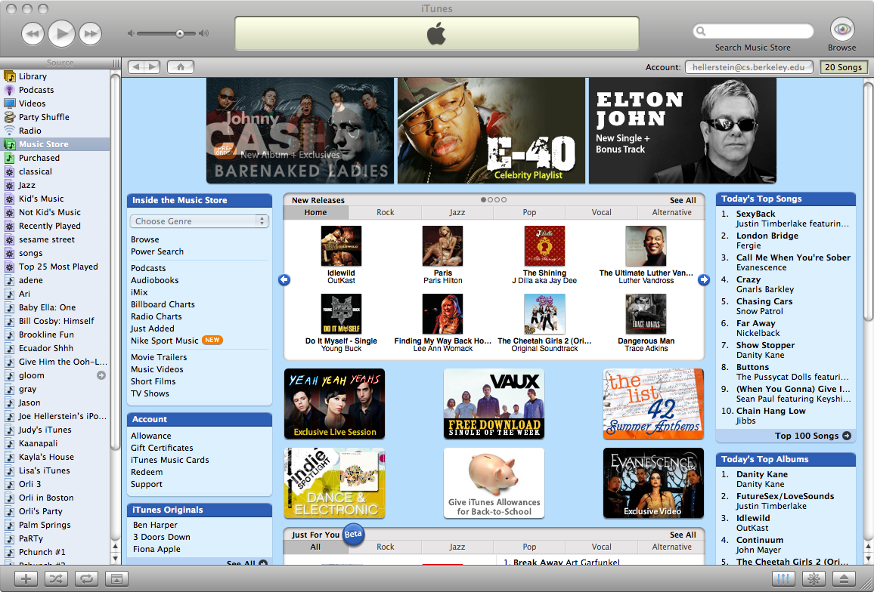
Database Systems Today
Notes:
‹#›

Slide 5
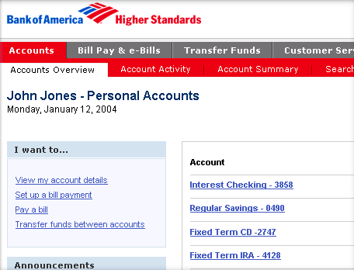
Database Systems Today
Notes:
‹#›

Slide 6
What is a Database?
“A set of information held in a computer”
Oxford English Dictionary
“One or more large structured sets of persistent data, usually associated with software to update and query the data”
Free On-Line Dictionary of Computing
“A collection of data arranged for ease and speed of search and retrieval”
Dictionary.com

Slide 7
Database Management Systems
A DBMS is a collection of programs which
provide management of databases
control access to data
contain a query language to retrieve information easily
DBMS
Application
program
End-user

Slide 8
Database Management Systems
DBMS contains information about a particular enterprise
Collection of interrelated data
Set of programs to access the data
This data is called database
DBMS
Application
program
End-user

Slide 9
DBMS:
DBMS contains information about a particular enterprise
Collection of interrelated data
Set of programs to access the data
This data is called database
Goals of DBMS
Provide an environment that is both convenient and efficient
Manage large bodies of information
Ensure the safety and security of the information
Avoid possible anomalous results

Slide 10
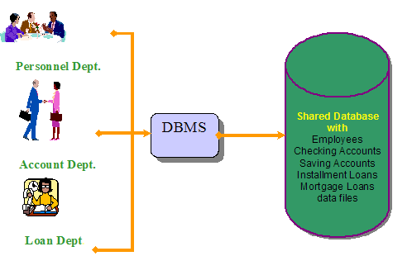
DBMS:
Application
Banking: All transactions

Slide 11

DBMS:
Application
Airlines: Reservations, schedules

Slide 12
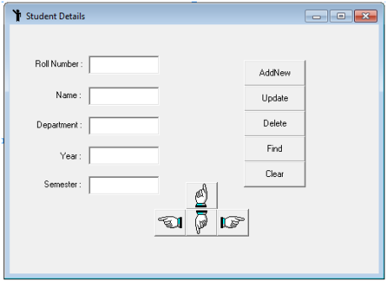
DBMS:
Application
Universities: Registration, grades

Slide 13

DBMS:
Application
Sales: Customers, products, purchases

Slide 14

DBMS:
Application
Online retailers: Order tracking, customized recommendations

Slide 15

DBMS:
Application
Manufacturing: Production, inventory, orders, supply chain

Slide 16

DBMS:
Application
Human resources: Employee records, salaries, tax deductions
Databases touch all aspects of our lives

Slide 17
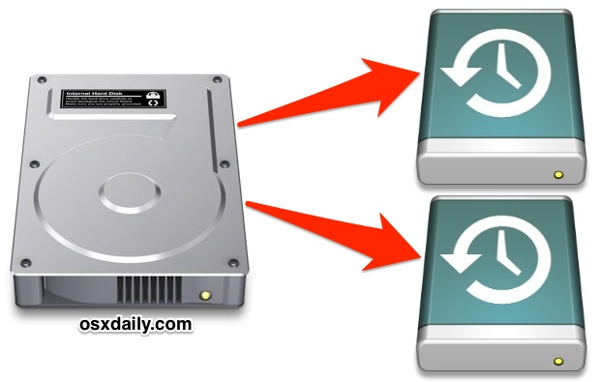
Purpose of DBMS:
Ordinary file system has a number of major drawbacks
Data redundancy and inconsistency
Multiple file formats, duplication of information in different files
Higher storage and access cost
Duplicate data leads to data inconsistency

Slide 18

Purpose of DBMS:
Ordinary file system has a number of major drawbacks
Difficulty in accessing data
Need to write a new program to carry out each new task

Slide 19
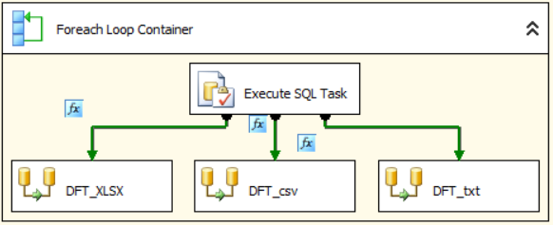
Purpose of DBMS:
Ordinary file system has a number of major drawbacks
2. Data isolation
Multiple file formats, duplication of information in different files
Writing new application programs to retrieve the appropriate data is difficult.

Slide 20

Purpose of DBMS:
Ordinary file system has a number of major drawbacks
3. Integrity problems
Integrity constraints (e.g. account balance > 0) become “buried” in program code rather than being stated explicitly
Hard to add new constraints or change existing ones

Slide 21
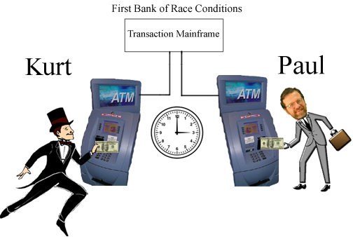
Purpose of DBMS:
Ordinary file system has a number of major drawbacks
4. Atomicity problems
Failures may leave database in an inconsistent state with partial updates carried out
Example: Transfer of funds from one account to another should either complete or not happen at all

Slide 22
Purpose of DBMS:
Ordinary file system has a number of major drawbacks
5. Concurrent-access anomalies
Concurrent accessed needed for performance
Uncontrolled concurrent accesses can lead to inconsistencies
Example: Two people reading a balance and updating it at the same time

Slide 23

Purpose of DBMS:
Ordinary file system has a number of major drawbacks
6. Security problems
Hard to provide user access to some, but not all, data
every user of the database system should be able to access all the data
Database systems offer solutions to all the above problems

Slide 24
Data abstraction:
Database designer need to use complex data structure
All user are not computer trained-hide the complexity
Level of abstraction
Physical level
Logical level
View level

Slide 25
Data abstraction:
Physical level
Describes how data are actually stored
Describes complex low-level data structures in detail
Logical level
Describes what data stored in database
Describes what relationships exist among those data
View Level
Describe only part of the entire database.
Views can also hide information (such as an employee’s salary) for security purposes.

Slide 26
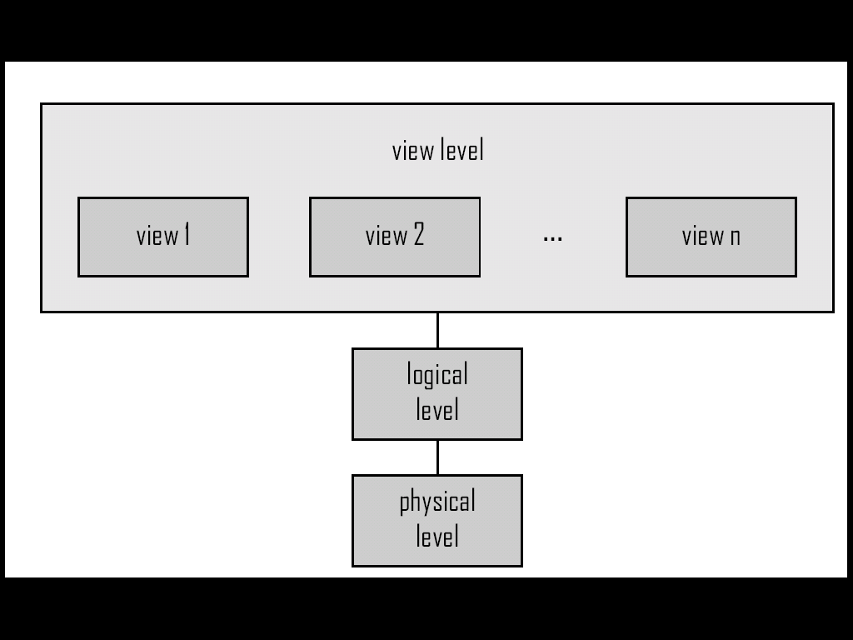
Data abstraction:

Slide 27
Instance and Schemas:
Schemas
The overall design of the database
Schemas are changed infrequently
Variable declaration (with type definition) of a programming language
Instance
Actual content of the database at a particular point in time
Analogous to the value of a variable

Slide 28
Some Commercial Database Management Systems
Oracle – Oracle 8i, Oracle9i, Oracle 10g
Microsoft SQL Server
IBM DB2/DB2UDB
Informix
Sybase
MySQL
Ingress
PostgreSQL

Slide 29
For Personal Computers
Microsoft Access
FoxPro
dBase

Slide 30
End

